Slide 1
EECS New Ph.D. Student Orientation
September 21, 2022

Slide 2
Welcome to the
Samueli School of Engineering
Electrical Engineering
and
Computer Science

Slide 3
SSoE Dean Dr. Magnus Egerstedt

Slide 4
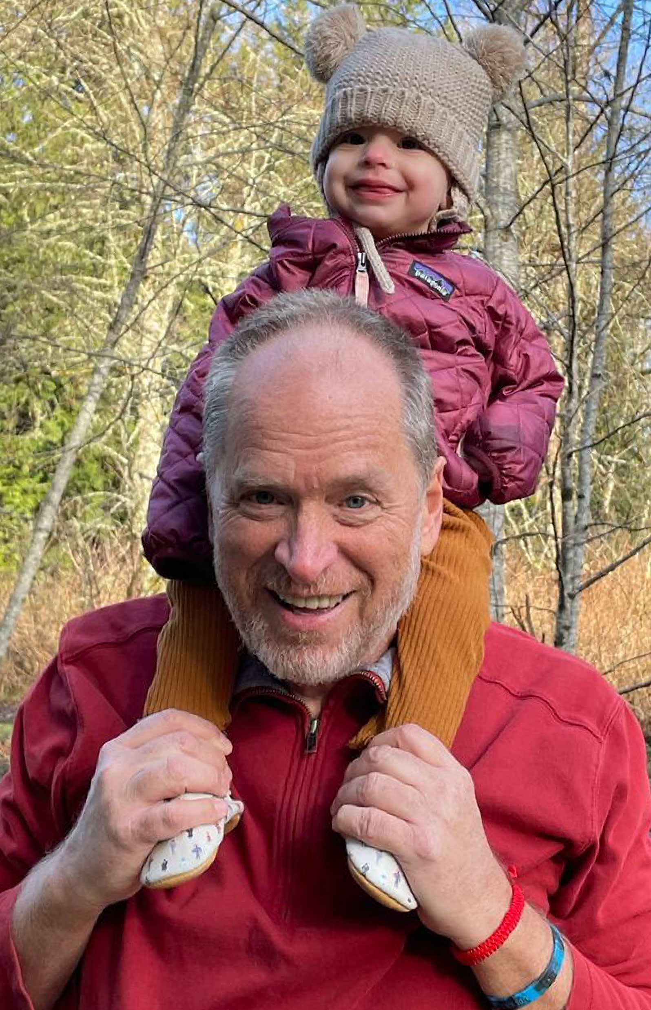
EECS Department Chair
Professor Lee Swindlehurst
and granddaughter -

Slide 5
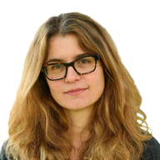
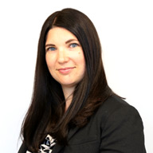
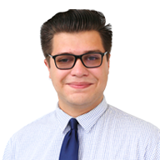
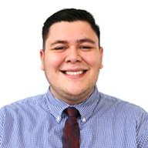
SSoE Graduate Professional Studies (GPS)
Athina Markopoulou
Associate Dean
Jean Macneil
Director
Mark Banderas Graduate Counselor
Enmanuel Gallardo Jr. Administrative Manager
Notes:
Mark

Slide 6
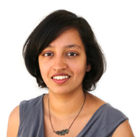
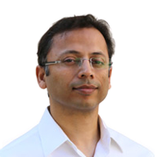
Graduate Advisors
Prof. Aparna Chandramowlishwaran
Graduate Advisor – PhD Programs
Prof. Syed Jafar
Graduate Advisor - MS Programs

Slide 7
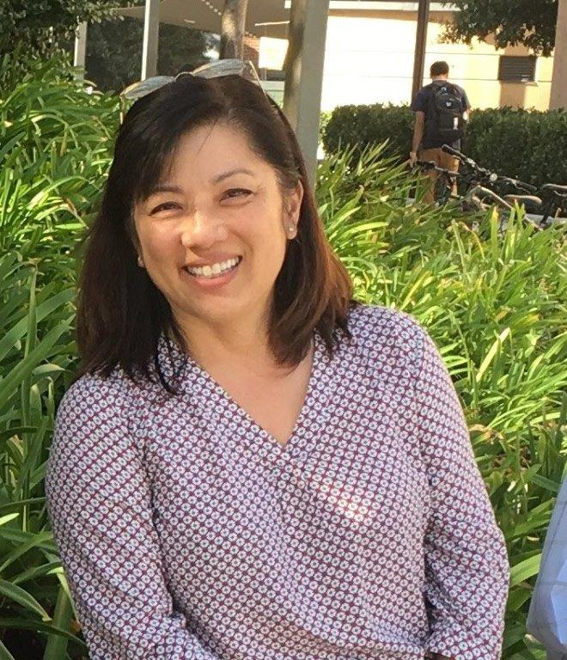
EECS Chief Administrative Officer
Julie Strope, CAO

Slide 8
Equity in Engineering
The Inclusion, Diversity, Equity, Anti-Racism, Access (IDEAA) team welcomes you to the Samueli School of Engineering at the University of California, Irvine!
We invite you to visit the IDEAA website to view resources (book, videos, articles, and much more!), to get involved, view support offices, and to be heard.
https://sites.uci.edu/equityinengineering/

Slide 9
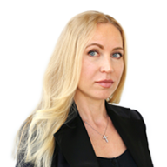
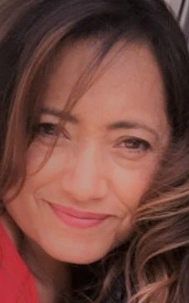
Academic Personnel and Payroll
Luba Konkova Payroll & Personnel Coordinator
Elvia Salas Academic Personnel Coordinator

Slide 10
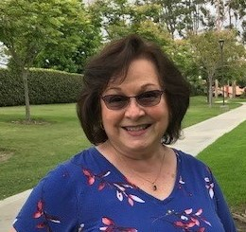
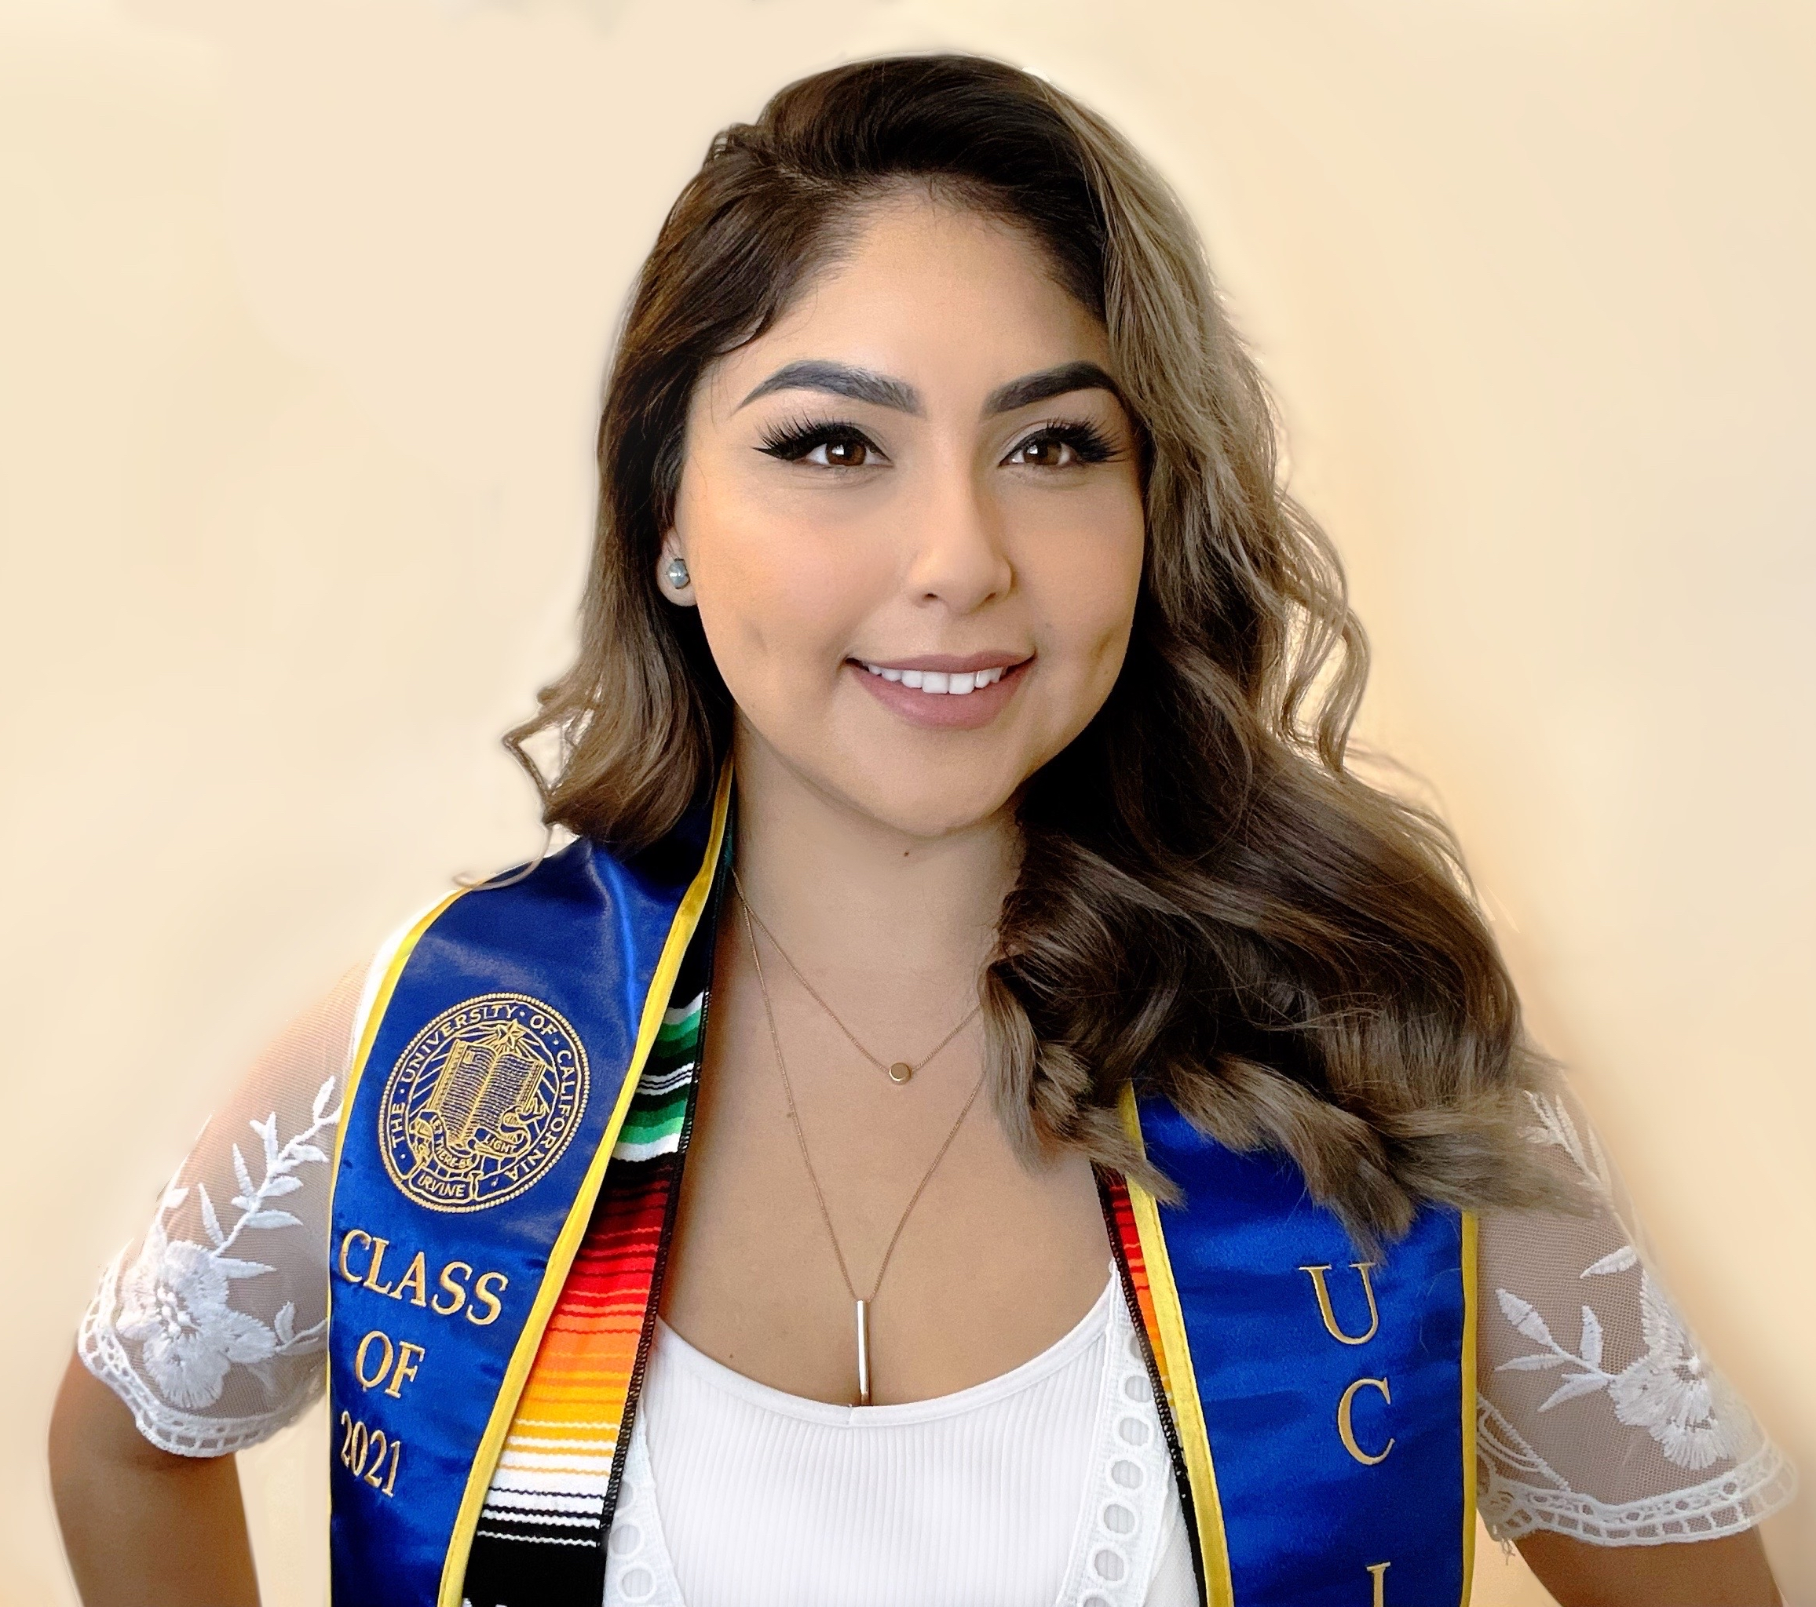
Undergraduate and Office Personnel
Pauline Eatherly Undergraduate Program Coordinator
Jasmine Garcia Business Office Analyst

Slide 11
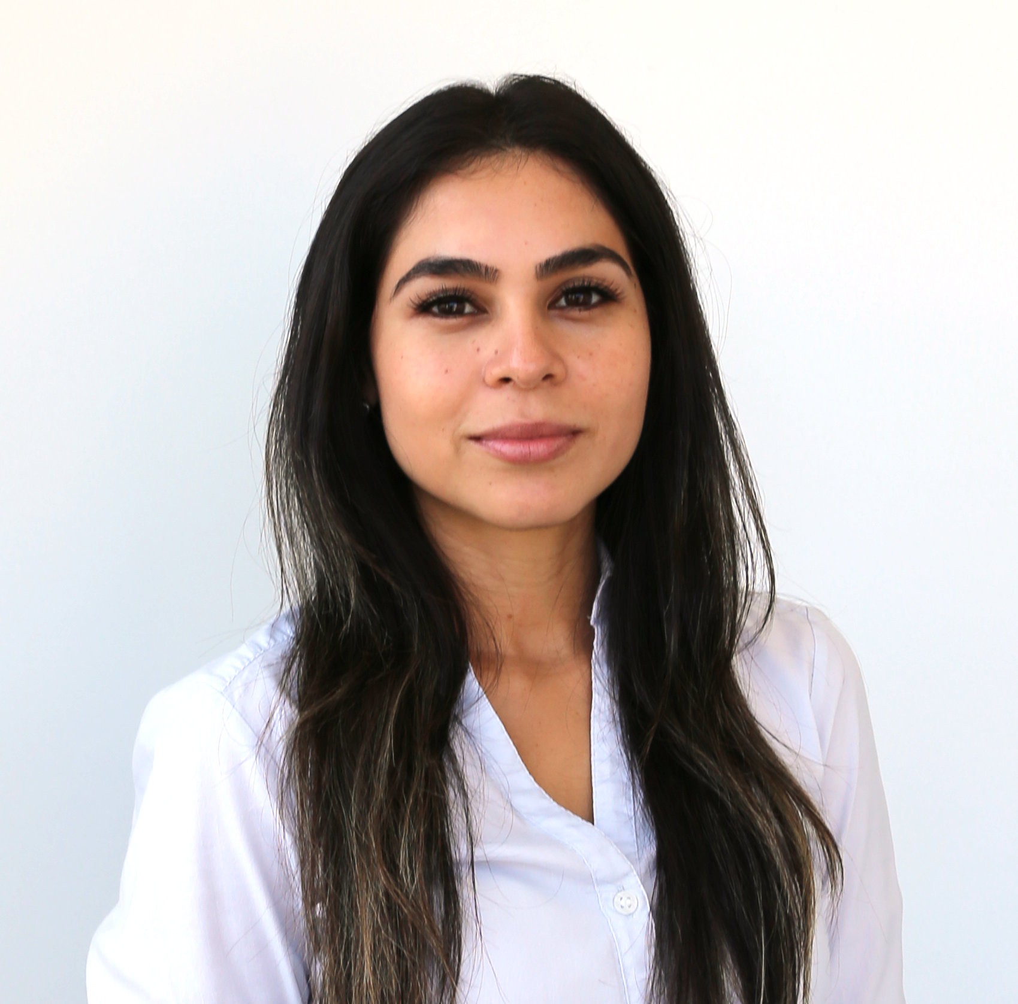
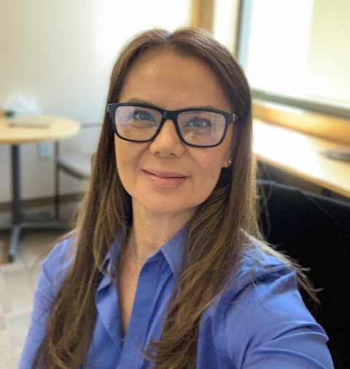
Admissions and Student Affairs
Stephany Monterroso Graduate Coordinator
Amy Pham Graduate Program Coordinator

Slide 12
EECS Department
Lee Swindlehurst
Chair
swindle@uci.edu
Aparna Chandramowlishwaran
Graduate Advisor – PhD Programs
amowli@uci.edu
Syed Jafar
Graduate Advisor – MS Programs
syed@uci.edu
Julie Strope
Chief Administrative Officer
jstrope@uci.edu
Amy Pham
Graduate Program Coordinator
amy.pham@uci.edu
Stephany Monterroso
Graduate Coordinator
s.monterroso@uci.edu
Luba Konkova
Payroll & Personnel Coordinator
lkonkova@uci.edu
Elvia Salas Academic Personnel Coordinator
salase@uci.edu
Pauline Eatherly
Undergraduate Programs Coordinator
peatherl@uci.edu
Jasmine Garcia
Business Office Analyst
jogarci1@uci.edu
Notes:
Stephany – Closing and introduce Luba. We are going to go ahead and now speak about employment and payroll, so Luba go ahead…..

Slide 13
4 year funding offer
Funding will be paid as:
3 Quarters Fellowship (Department)
3 Quarter TA-ship (Department)
Required to take and pass English Proficiency in Year 1
Required to take Teaching Assistant Professional Development Program (TAPDP) training by Beginning for Year 2
GSR appointment (PhD Faculty Advisor)
*Your PhD advisor will decide “how” you will be funded each quarter*

Slide 14
TA’s, Reader’s and GSR’s
Graduate students may be employed as Graduate Student Researchers, Teaching Assistants or Readers.
The decision to support Ph.D. student as GSR’s is determined by your Faculty Advisor
UAW orientation is mandatory for first time ASE (Academic Student Employee) Fall 2022 UAW Orientation for Readers and Tutors:
Date: Monday, September 19th from 3:30-4:00 pm.
https://fiu.zoom.us/j/9155817788 Fall 2022 TA Professional Developemnt Program (TAPDP) Training
Date: Monday, September 19th - Wednesday, September 21st

Slide 15
Teaching Assistants (TA’s)
TA’s are hired on a quarterly basis
Student must have taken the course or equivalent
Student must take the mandatory TAPDP training
International and Permanent Resident must meet English Proficiency Requirement
Minimum 3.1 GPA requirement
Full-time student status
More information: http://www.eng.uci.edu/dept/eecs/graduate/teaching-assistants-and-readers Fall 2022 TA Professional Developemnt Program (TAPDP) Training
Date: Monday, September 19th - Wednesday, September 21st Winter 2023 TAPDP Training
Date: TBA

Slide 16
Readers
Hire every quarter (2nd week)
English Proficiency is not required.
3.0 GPA
Can be part-time student status
Contact Professor for interview
Professor will contact Department with selection list
Department will contact you to set up employment
First time readers must attend UAW orientation (Orientation is offered every quarter by Graduate Division)
First-time ASEs: attend UAW orientation
Fall 2022 UAW Orientation for Readers and Tutors:
Date: Monday, September 19th from 3:30-4:00 pm. https://fiu.zoom.us/j/9155817788 Winter 2023 UAW Orientation for Readers and Tutors:
Date: To be announced

Slide 17
Steps to being hired
Complete and submit TA application form to Luba
Contact instructor of the course you want to TA for and request an interview
Instructor will notify EECS with their selections
Department will email you for any paperwork requirements
Pay:
GSR: Monthly salary and fees
TA’s: Monthly salary and fees ($164.33 local fees will be paid by the student- not by the department)
Graders/Readers: every other Wednesday (hourly pay only)

Slide 18
Steps to be hired Summer Session TA
Summer TA employment is appointed by the Summer Session (not by EECS Department)
Contact the instructor of the summer course. If selected, the instructor will send your name to the Curriculum, Analytical Studies, & Accreditation (CASA) Office.
CASA will provide a list of vetted TA’s to Summer Session.
Summer Session will contact you for hiring paperwork

Slide 19
Direct Deposit – Payment https://fs.uci.edu/student-billing/direct-deposit-deft.php
GSR- TA
Fellowship
UCPath Online –student employees To receive payments from the Payroll system, graduate students with employment appointments must use UCPath Online.
Salary paid after the quarter ends Fall Quarter: October stipend: paid November 1st November stipend: paid December 1st December stipend: paid January 1st
ZOT Account – all students To receive payments from your ZOT Account (including refunds and financial aid disbursements), access DEFT by clicking the “Electronic Refunds” link in the navigation sidebar. Financial aid recipients are required to select a delivery option prior to disbursement with mail becoming the default
Stipend paid at the beginning of the Month Fall Quarter:
October stipend: paid October 1st November stipend: paid November 1st December stipend: paid December 1st

Slide 20
International students Glacier, SSN, ITIN
Glacier: https://accounting.uci.edu/tax/non-resident/index.html
Social Security (SSN): https://ic.uci.edu/resource-pages/social-security.php
Individual Taxpayer Identification number (ITIN) https://ic.uci.edu/resource-pages/individual-taxpayer-identification-number.php

Slide 21
Roadmap to Ph.D.
- Total of 12 units required
- Initiate research
- Research Units every quarter
- Courses (optional)
- 4 quarters of EECS 294
Choose research advisor
Advisor Form (1st yr)
- Confirm and work towards dissertation topic
- Form Ph.D. committee
Submit:
- Complete dissertation
- Ph.D. form II
- Diploma & Commencement form
Preliminary examination
Qualifying
examination
Submit
Ph.D. form I
- Complete
dissertation
1st quarter
By the 4th quarter in Ph.D. program

Slide 22
Ph. D. Faculty Research Advisor
In order to remain in good academic standing, newly admitted student must be matched with a faculty research advisor no later than 12 months from the beginning of the student’s first quarter of PhD study.
In order to remain in good academic standing, continuing students who are switching advisors (for whatever reason) must match with a new faculty research advisor no later than by the end of the subsequent quarter (excluding summer term).
Once you have matched with a faculty research advisor, please submit the Ph.D. Faculty Research Advisor Verification Form. Please note that matching with a faculty research advisor is independent of locating funding for a student's studies.

Slide 23
How to
Find an Advisor and research topic EECS Faculty Affiliated Faculty
Changing Advisors Ph.D. Faculty Research Advisor Verification Form
Financial Support

Slide 24
Ph.D. Prelim Exam
PhD students
Must submit signed form by end of second week of arriving quarter
Must obtain an "A-" letter grade in 3 of the 5 courses (with the advisor’s recommendations)
1 course can be selected from outside the EECS department or another UC university (with written approval of the advisor)
Course cannot be transferred from another university. Courses needs to be completed at UCI (in UC System with approval)
Must meet requirements within 4 quarters from start of PhD program
PhD students who are required to earn MS degree along the way toward completion of your Ph.D.
Courses taken during MS degree can count towards Prelim requirements
Additional courses can be recommended by Advisor for the Prelims requirements if necessary
Must meet requirements within 4 quarters from start of PhD program
*Information Session will be held on October 4 at 1:00PM

Slide 25
Courses Requirements
12 units are required each quarter
EECS 294 (Required) : students must complete for four quarters
EECS299- Individual Research: Students can choose between 1-16 variable units. Students should sign up for these units if they are conducting individual research under a faculty instructor.
EECS297- PhD Thesis Research: Students can choose between 1-16 variable units. Students should sign up for these units if they are conducting PhD thesis/dissertation research under a faculty advisor. (taken after you have passed your Qualifying Exam)
EECS293- PhD Prelim Exam Preparation: Students can choose between 1-8 variable units. This is a filler course used to assist PhD students in maintaining the 12 unit per quarter minimum. Please note that 8 units is the maximum number you can use as "filler" for the entirety of your graduate career. Your other units are expected to be legitimate courses, seminars, research units, etc.
Courses required to meet the PhD Prelim requirements
You must receive a letter grade for at least one courses. If you only receive S/U grades your GPA will be 0.

Slide 26
EECS Seminar Series EECS 294
4 quarters of EECS 294 required
Seminars at least 5 times per quarter – set dates
Required to attend 4 out of the 5 seminars
Final quiz (option to take in-person or online)
Offered every Quarter
1 unit course
Graded as S/U
Please check website for more information: https://engineering.uci.edu/dept/eecs/events/seminar-series

Slide 27
PhD Qualifying Exam
Set your dissertation topic and completed most of the initial research
Form your Candidacy Committee, which comprises 5 U.C. Academic Senate members. This committee must include:
Chair: Your research advisor. The Chair must be a faculty member of the EECS Department or has a joint appointment.
General Members: At least 2 of the 3, must hold appointment in EECS
Outside Member: Must be a UCI faculty member who does not hold an appointment in EECS.
Submit the nomination form of your committee to Amy Pham (at least two weeks before the date of the Ph.D. qualifying examination.
The PhD Form I will be prepared by Amy the night before your exam. Graduate Division will send it via DocuSign for signature
Doctoral committee will need to be listed on your PhD Form I
Non-resident students who have passed the Qualifying Examination are eligible for a 100% reduction in their non-resident supplemental tuition for 9 quarters. (if you do not confer your degree within the 9 quarters, NRST will be charged until you do so)

Slide 28
Completion of Dissertation
Decide a time and place for your defense, when your doctoral committee members are available.
Inform EECS graduate office, Amy Pham, the time and place with a copy of your abstract (one paragraph describing your presentation) at least one week before the date of your defense.
Doctoral Committee was determined on your PhD form I. Notify Amy if it has changed.
Defend your dissertation
Ph.D. Form II will be prepared by Amy Pham the night before you defend. Graduate Division will send it via DocuSign form signature.
The Standards and Procedures Manual for writing and submitting thesis/dissertations is available at: http://special.lib.uci.edu/

Slide 29
DocuSign Form
Forms can only be submitted by using Graduate Division DocuSign forms links
Forms will be prepared by the EECS Department staff and sent via DocuSign for signatures.
All forms are routed to the following (the order of signer depends on the form):
Student
Faculty advisor
Department
School of Engineering (GPS office)
International Center (if applicable)
Graduate Division
**Please notify Amy Pham when you are ready to submit a form**

Slide 30
Part-time vs Filing Fee
Part-Time Study
PhD students cannot be part-time.
Filing-Fee
Filing fees applies to students who have completed all requirements for a terminal Master's degree or a Doctoral degree and are ready for the formal submission of their thesis or dissertation, or the final, formal examination. The filing fee status can be used for one quarter only during the student's entire graduate training. Students applying for Filing Fee status must have been registered in the preceding academic session. A filing fee will not be accepted immediately following an academic leave of absence
You must fill out the Filing Fee Petition, located at Graduate Division Forms, and turn it into your Graduate Coordinator (Amy). Filing Fee students may not be enrolled in units. You will not be considered for Filing Fee status unless this form is submitted.
International students can only apply for Part-time or Filing Fee status in the quarter your degree is being conferred. Additional forms are required for the International Center

Slide 31
Fees & Tuition
Everyone, domestic and international students, pays the California Resident fee and tuition amount of $18,516.84 for Academic year 2022-23 ($6,206.46 for Fall Quarter, $6115.46 for Winter Quarter and $6,194.92 for Spring Quarter).
Nonresidents (international students and domestic students who have not been established California Residency status) will pay, in addition to the $18,516.84 CA Tuition, a Nonresident Supplemental Tuition of $15,102.00 a year ($5034. per quarter), totaling $33,618.84
Out of state domestic student will need to establish residency at the end of Spring 2023
(submit Graduate Petition for Residence Classification between June 1st –August 1st)
Graduate students are assessed the one-time document fee. Provides lifetime access to official transcripts and academic verifications without a fee for in-person pickup or delivery by USPS
https://www.reg.uci.edu/fees/2022-2023/graduate.html

Slide 32
NonResident Supplemental Tuition (NRST) Remission Program
The non-resident supplemental tuition (NRST) remission initiative program provides NRST fellowship support to international PhD and MFA students in an effort to reduce costs on faculty grants and departmental funds.
Cohorts enrolling before 2015 – No NRST support
Cohorts enrolling 2015-2018: NRST support for years 2 through 4 for PhD students and 2 and 3 for MFA students for students who are employed or on fellowships of equivalent levels that would typically generate remission (25% time for ASE or GSR, equivalent level for fellowship).
Cohorts enrolling 2019-2020: NRST years 2 through 4 for PhD students and years 2 and 3 for MFA students who hold a remission-eligible appointment in an ASE (Teaching Assistant/Associate, Reader or Tutor) or GSR title at a minimum of 25% time.
Cohorts enrolling 2021 and beyond: NRST for years 2 and 3 for PhD and MFA students who are employed or on fellowships of equivalent levels that would typically generate remission (25% time for ASE or GSR, equivalent level for fellowship).
Students must also meet all other academic requirements for fellowship support (i.e. grades, GPA, etc.) in order to receive NRST support from this program.
https://www.grad.uci.edu/admissions/international-students/index.php

Slide 33
NonResident Supplemental Tuition (NRST) Remission Program
PhD students entering Fall 2022 are qualified for The Graduate Division’s NRST remission program starting in Fall 2023
NRST will be covered by the remission program starting Fall 2023 until Spring 2025 or until you pass your Qualifying Exam, whichever comes first.
In Fall 2023, the TA-ship or GSR appointment will pay a salary and only cover the CA tuition. The NRST amount of $5034. will be covered by The Graduate Division NRST Remission Program.
*NOTE: if you change your degree level from PhD to MS, you will no longer qualify for this program and will be required to pay the NRST.

Slide 34
Curricular Practical Training (CPT) Immigration requirements
Curricular based off-campus internship/work permission for F-1 international students
Eligibility:
F-1 Student enrolled for at least one (consecutive) academic year before you are eligible to apply for CPT
Job offer must be related to your field of study
You must obtain CPT authorization PRIOR to beginning your internship
Must be registered for ENGR 291
Must be enrolled and cannot be used if you are on "filing fee status"
Other key points:
Can only intern/work part time, up to 20 hours a week during the academic year
Can intern/work full time, up to 40 hours a week during the summer
More information: International Center’s website:
http://www.ic.uci.edu/students/F1Current/cpt.php

Slide 35
CPT Academic requirement
Preparing your CPT Application and Enrolling in ENGR 291 Internship
Review International Center’s CPT Online Tutorial
CPT Internship Approval Form (for Ph.D. students only)
Independent Study form (only if seeking CPT during summer terms)
ENGR 291 Internship Course Requirements
A 2-page summary report describing the company and its products or services, the technical aspects of the position, courses that you took that helped you prepare for this role, and your professional goals as they relate to your graduate degree at UCI.
A rating from your internship supervisor as either good/fair/poor and/or an overall assessment of your work emailed to gradengr@uci.edu.
For any questions about CPT application, ENGR 291 Internship enrollment, or grading, please visit https://engineering.uci.edu/current/graduate/curricular-practical-training or contact gradengr@uci.edu.

Slide 36
Optional Practical Training (OPT)
Optional Practical Training (OPT) is work authorization available to international students who have been in valid F-1 status for one academic year and who plan to seek employment in the U.S. in their field of study.
Key points:
Submit your OPT I-20 request form to the Graduate Coordinator to complete “Completion Verification” section
The earliest you can apply for OPT is 90 days before your program end date
The latest date the United States Citizenship and Immigration Services (USCIS) will accept your application is 60 days after your program end date
Total of 12 months
24 months of STEM extension eligibility
More information: International Center’s website (search OPT in the search box)
http://www.ic.uci.edu/students/F1Current/opt.php

Slide 37
Important URLs
EECS Website:
http://www.eng.uci.edu/dept/eecs/graduate
Information about degree requirements, degree progression, policies and procedures.
School of Engineering website:
http://www.eng.uci.edu/current/graduate
Engineering Student Handbook, Deadlines, forms, Policy procedures and Resources
Graduate Division Forms Website:
http://www.grad.uci.edu/forms/index.html
Almost every form you’ll ever need including Advancements, Petitions, etc. Included at http://www.grad.uci.edu are important dates, deadlines, and other information.
International Center Website:
http://www.ic.uci.edu/
Visa information, OPT/CPT Forms and other important information.
Registrar Website:
http://www.reg.uci.edu/
How to register, enrollment issues, tuition and fees, and other account information.

Slide 38
Office Hours
Aparna Chandramowlishwaran
PhD Graduate Advisor EECS Department EH 4432 EH 2217
Office hours: Tuesdays: 1:00PM - 2:00PM
Zoom link: https://uci.zoom.us/j/99217443210
Email: amowli@uci.edu
Amy Pham
Graduate Program Coordinator EECS Department
EH 2201
Business hours: M-F 8:00AM - 5:00PM
Office hours: Tuesday: 10:30AM - 11:30AM
Email: amy.pham@uci.edu
Mark Banderas,
Graduate Counselor
Graduate and Professional Studies School of Engineering
204 Rockwell Engineering Center
Business hours: M-F: 9:00AM - 4:00PM,
Closed 12:00PM-1:00PM
mark.banderas@uci.edu
Email for appointment: gradengr@uci.edu
Jean Macneil
Director
Graduate and Professional Studies School of Engineering
204 Rockwell Engineering Center
Business hours: M-F: 9:00AM- 4:00PM,
Closed 12:00PM-1:00PM
jean.macneil@uci.edu
Email for appointment: gradengr@uci.edu
Notes:
Stephany – Send us an email in advance to set up the meeting and avoid schedule conflicts

