Slide 1
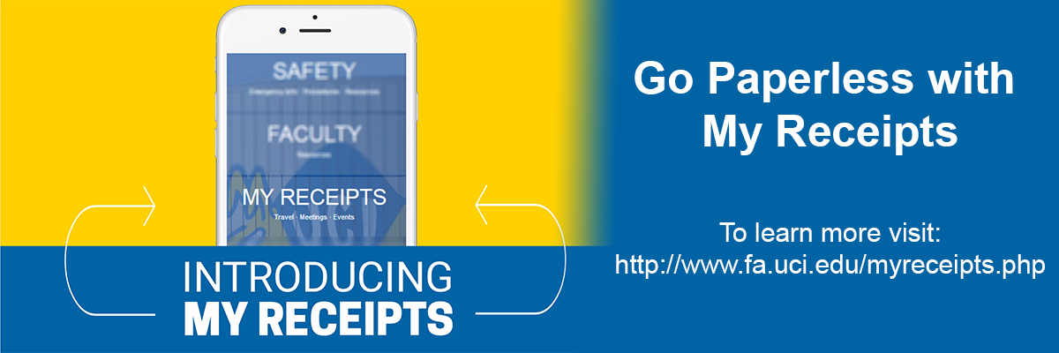
UCI With U For U App
My Receipts is a feature in the With U • For U mobile app that makes it quick and easy to collect, store, and share receipts (and other supporting documents) for reimbursement of business travel and events. Instead of holding on to paper receipts and remembering to give them to your arranger for reimbursement, use this tool to take photos of your receipts and store them in one place—an electronic filing cabinet in the cloud.
*Share your receipts by simply sending a notification email to your arranger or SOE Purchasing- soepurchasing@uci.edu when prompted by App.

Slide 2
SNAP receipt, SHARE with arranger
Open the With U · For U mobile app and click on the My Receipts tile.
Select "Upload My Receipts,” and login with your UCInetID.
Click on "Add New Trip/Event."
Enter a trip/event Title, Primary City, Start Date, End Date and optional Business Purpose, and click on "Save & Upload Images."
Upload images using your device's camera (images will not be stored locally); or upload images already saved on your device (supported file types include .gif, .jpg, and .png).
Please ensure receipts are legible when uploading and submitting.
Within the My Receipts tool, select the trip or event you want to share, and then click “Notify” below the image gallery. This generates an email with a link for you to send to your arranger.

Slide 3
Go Paperless with My Receipts
If you have a single receipt it can be shared with an arranger right away.
If you have multiple receipts, in lieu of submitting one by one, save them in My Receipts electronic filing cabinet and submit all to your arranger or SOE purchasing when the event or trip is finished.
Arranger will download your receipt images, initiate a reimbursement document within KFS, and upload the images shared. Without the My Receipts tool, arrangers would have scanned paper receipts and/or uploaded receipts you shared electronically.
Images will be retained in My Receipts for six months after the end date of the trip or event.

Slide 4
SOE Implementation
Travel Reimbursement
Upload required receipts for Lodging, Airfare, Rental Cars, and any expenses over $75 and appropriate approvals and submit them to an arranger right away
If a reimbursement includes auxiliary expenses not requiring receipts, travel reimbursement form containing applicable logs is recommended way of organizing a travel reimbursement
An agenda or conference program are nice to include, but a detailed explanation of the purpose and/or the expected business benefit is sufficient.
Entertainment or Miscellaneous Reimbursement
If submitted by a PI:
Upload required receipts. In description provide: business purpose, attendee list, alcohol use cert and account number for ENT reimbursement and submit to an arranger. No reimbursement form/cover sheet needed.
A reason why proper purchasing methods were not used should be provided in the description area for MISC reimbursement
If submitted by a student:
Upload required receipts. Additionally, SOE Entertainment or Miscellaneous form signed by PI or electronically authorized would include all appropriate statements and signature requirements.

